Slide 1


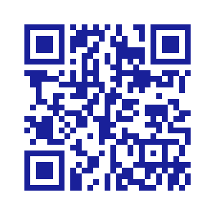
Shannon Lee
Director
Office of Stewardship and Development
Catholic Diocese of Salt Lake City
801-456-9328
shannon.lee@dioslc.org
www.dioslc.org/outreach/stewardship

Slide 2
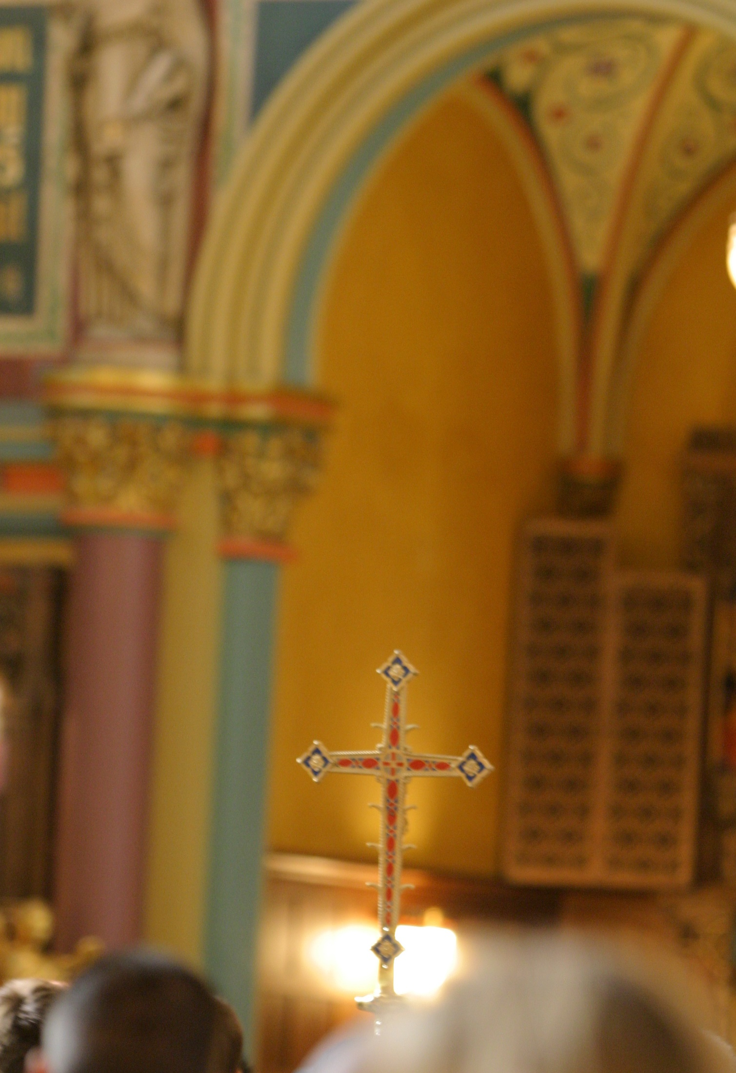
How to Form Our Catholic Giving
Notes:
Good afternoon. My name is Shannon Lee. I am the Director of Stewardship and Development at the Diocese of SLC.
For those of you who do not know me … I began at the Diocese in 2000 to run the Diocesan Development Drive. I left in 2013 and returned in 2020.
To give you a little bit of stewardship history, in 2010, Bishop Wester and I began a diocesan-wide effort to introduce stewardship to the parishioners in the Diocese of Salt Lake City. This included meetings with parish council members to introduce stewardship to a parish, yearly stewardship workshops, and yearly stewardship materials. Currently we have some parishes who continue to practice stewardship, and some do not. And some do and don’t realize they are technically a stewardship parish.
Since I returned in 2020 I have been working with Bishop Solis to revitalize this stewardship effort. I hope you all receive Bishop Solis’ monthly Stewardship Messages. If not, please let my staff or me know what your email address is and we will make sure you receive them. They are also located on the Stewardship, Our Way of Life page of the diocesan website.
When you arrived this afternoon, you received a folder with stewardship items. These are for you to review and speak to your pastor about. Also included is a form asking if you would like to be a Diocesan Stewardship Liaison. As we go through this presentation today, I encourage you to consider this important role. We can discuss it during the questions and answer portion of this presentation. When you complete the form please give it to Bryson Brown, our Development Associate who is also in the Office of Stewardship and Development.

Slide 3
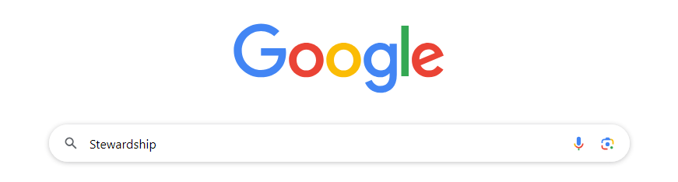
Notes:
I’m here to speak to you today about the Stewardship of Treasure. If you have heard me speak before you may know this piece of information:
According to Google, there are 2300 verses regarding Stewardship in the Bible. So, we have it on good authority that stewardship is not just a buzz word, or something you throw out when you want to sound cool. It is real and it is important.
Let’s explore a couple of those Biblical references.

Slide 4
Honor the Lord with your wealth, with first fruits.
Proverbs 3:9
Notes:
What does this mean? Let’s take a minute and think about the following scenario:
You’re sitting in your favorite pew at Mass. The choir is singing. The altar is being prepared, AND, the collection basket is being passed. And you think, “Oh I forgot they pass a collection basket. Let’s see how much money I have in my wallet. Oh no, here comes the basket, I’m not ready. Oh wait, here’s a dollar. Whew, I made it.
Is this what Proverbs means by “first fruits?”

Slide 5
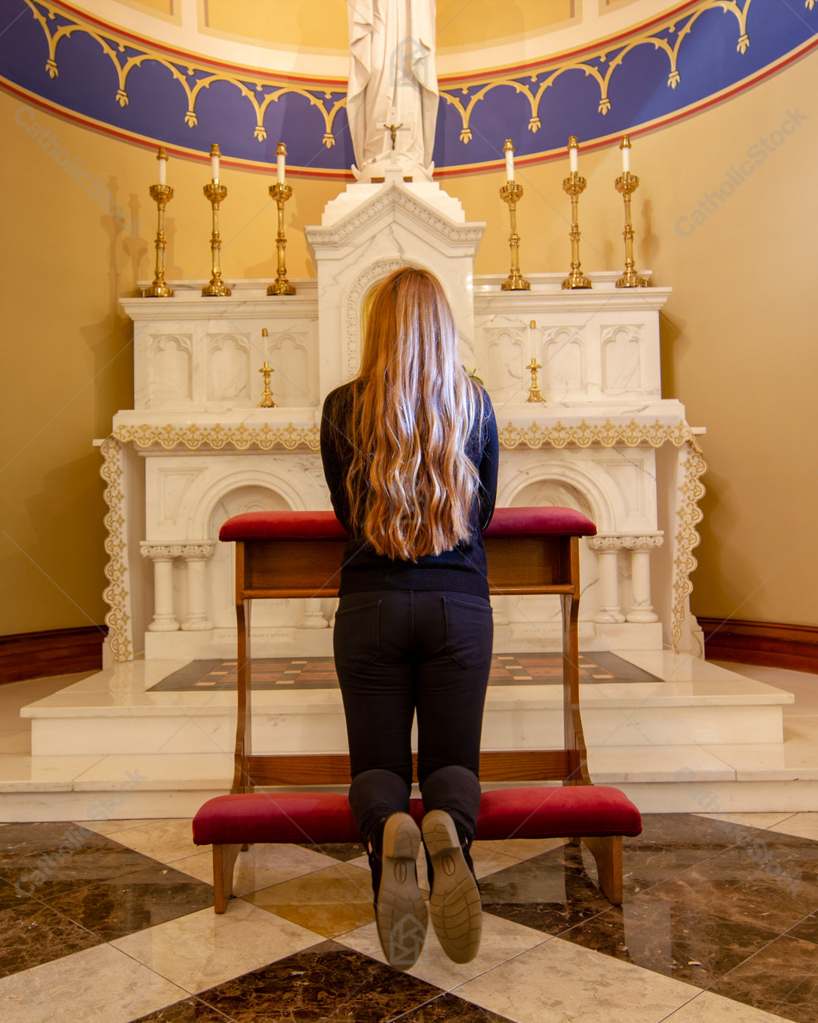
How shall I make a return to the Lord for all the good
He has done for me?
Psalm 116:12
Notes:
Read Verse …

Slide 6
How shall I make a return to the Lord for all the good
He has done for me?
Psalm 116:12
Notes:
That’s a tough one. “for all the good He has done for me.” Do I make a list? Do I count everything or just the big ones. So, if our Lord blesses me with children, for example, do I make sure my son becomes a priest, or my daughter becomes a nun? That’s a big one.
If the Lord gives me a house to live in, do I build a church for Him?
If I have a job that pays my bills then what do I do? How do I figure this out?
The woman in this image might be a clue.

Slide 7
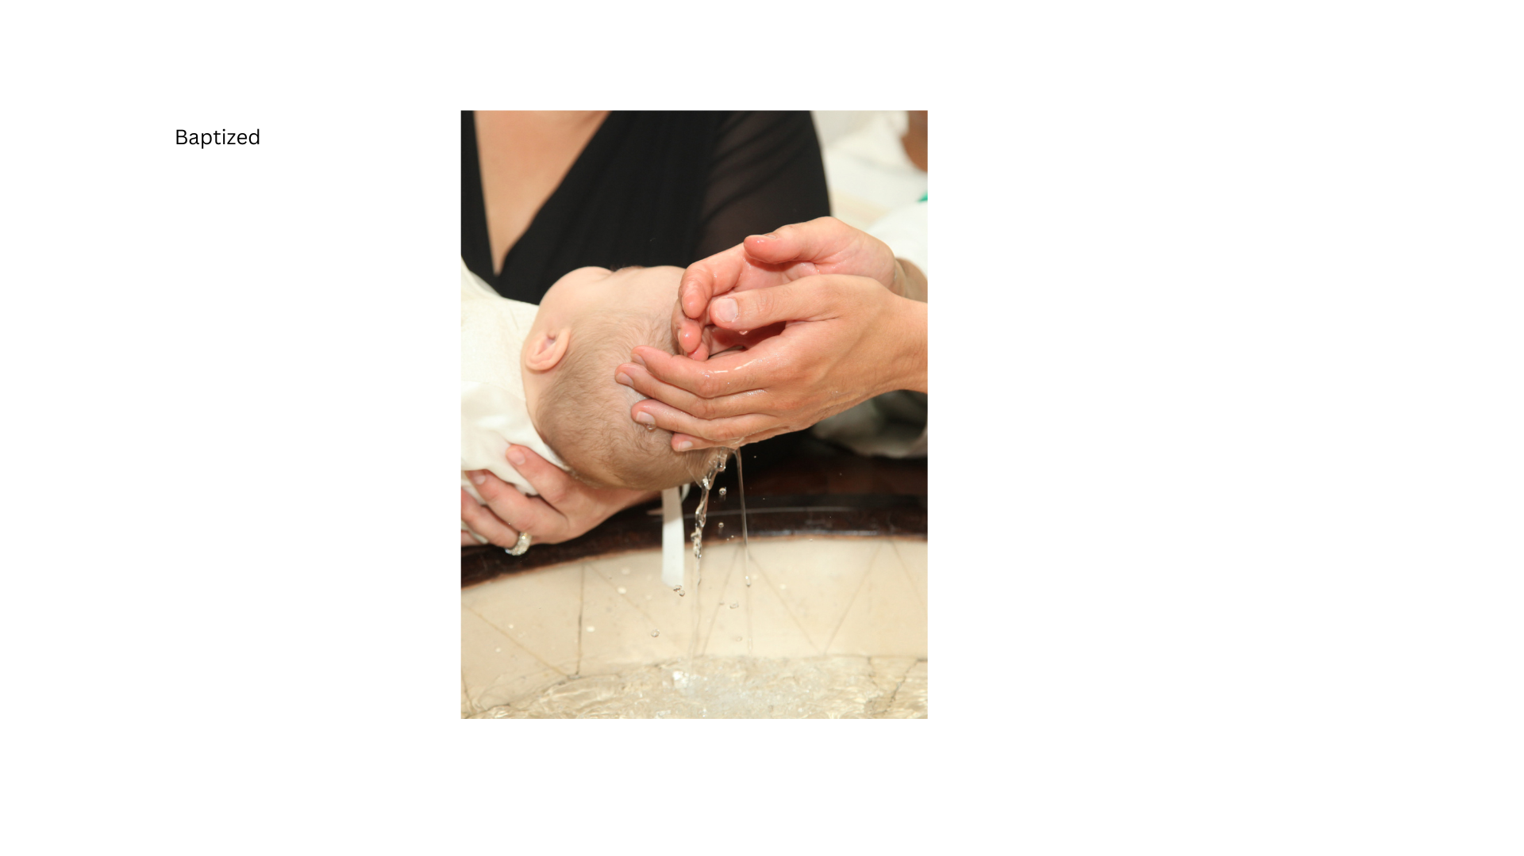
We should remember as baptized Catholics we are obliged to assist with the material needs of the Church, each according to his own ability.
Catechism of the Catholic Church, the Precepts of the Church, the fifth precept, 2043.
Notes:
Do you feel that Catholic guilt yet???
We all know we should give to charities. We’re Catholic.
We started learning this early when we were in grade school. Do you remember that box of chocolate bars you received and were told to sell them to your family and to your neighbors. Not to mention Girl Scout Cookies, sports fundraisers, dance class.
Then, as adults, we graduated to the big league: parish and school auctions.

Slide 8

Parish Offertory
Diocesan Development Drive
Catholic Foundation of Utah
Parish Capital Campaign
Second Collections
Community Charities
Notes:
But how do we decide what to do when everyone has their hand out. As a Catholic just walking into Mass, we have …
Then we return home and sitting on our kitchen counter is a mailer from the American Red Cross, the Alzheimer’s Association. The list goes on and on and on.

Slide 9
How shall I make a return to the Lord for all the good
He has done for me?
Psalm 116:12
Notes:
Read Verse …
I have an answer for you to this question, and it’s simple.

Slide 10
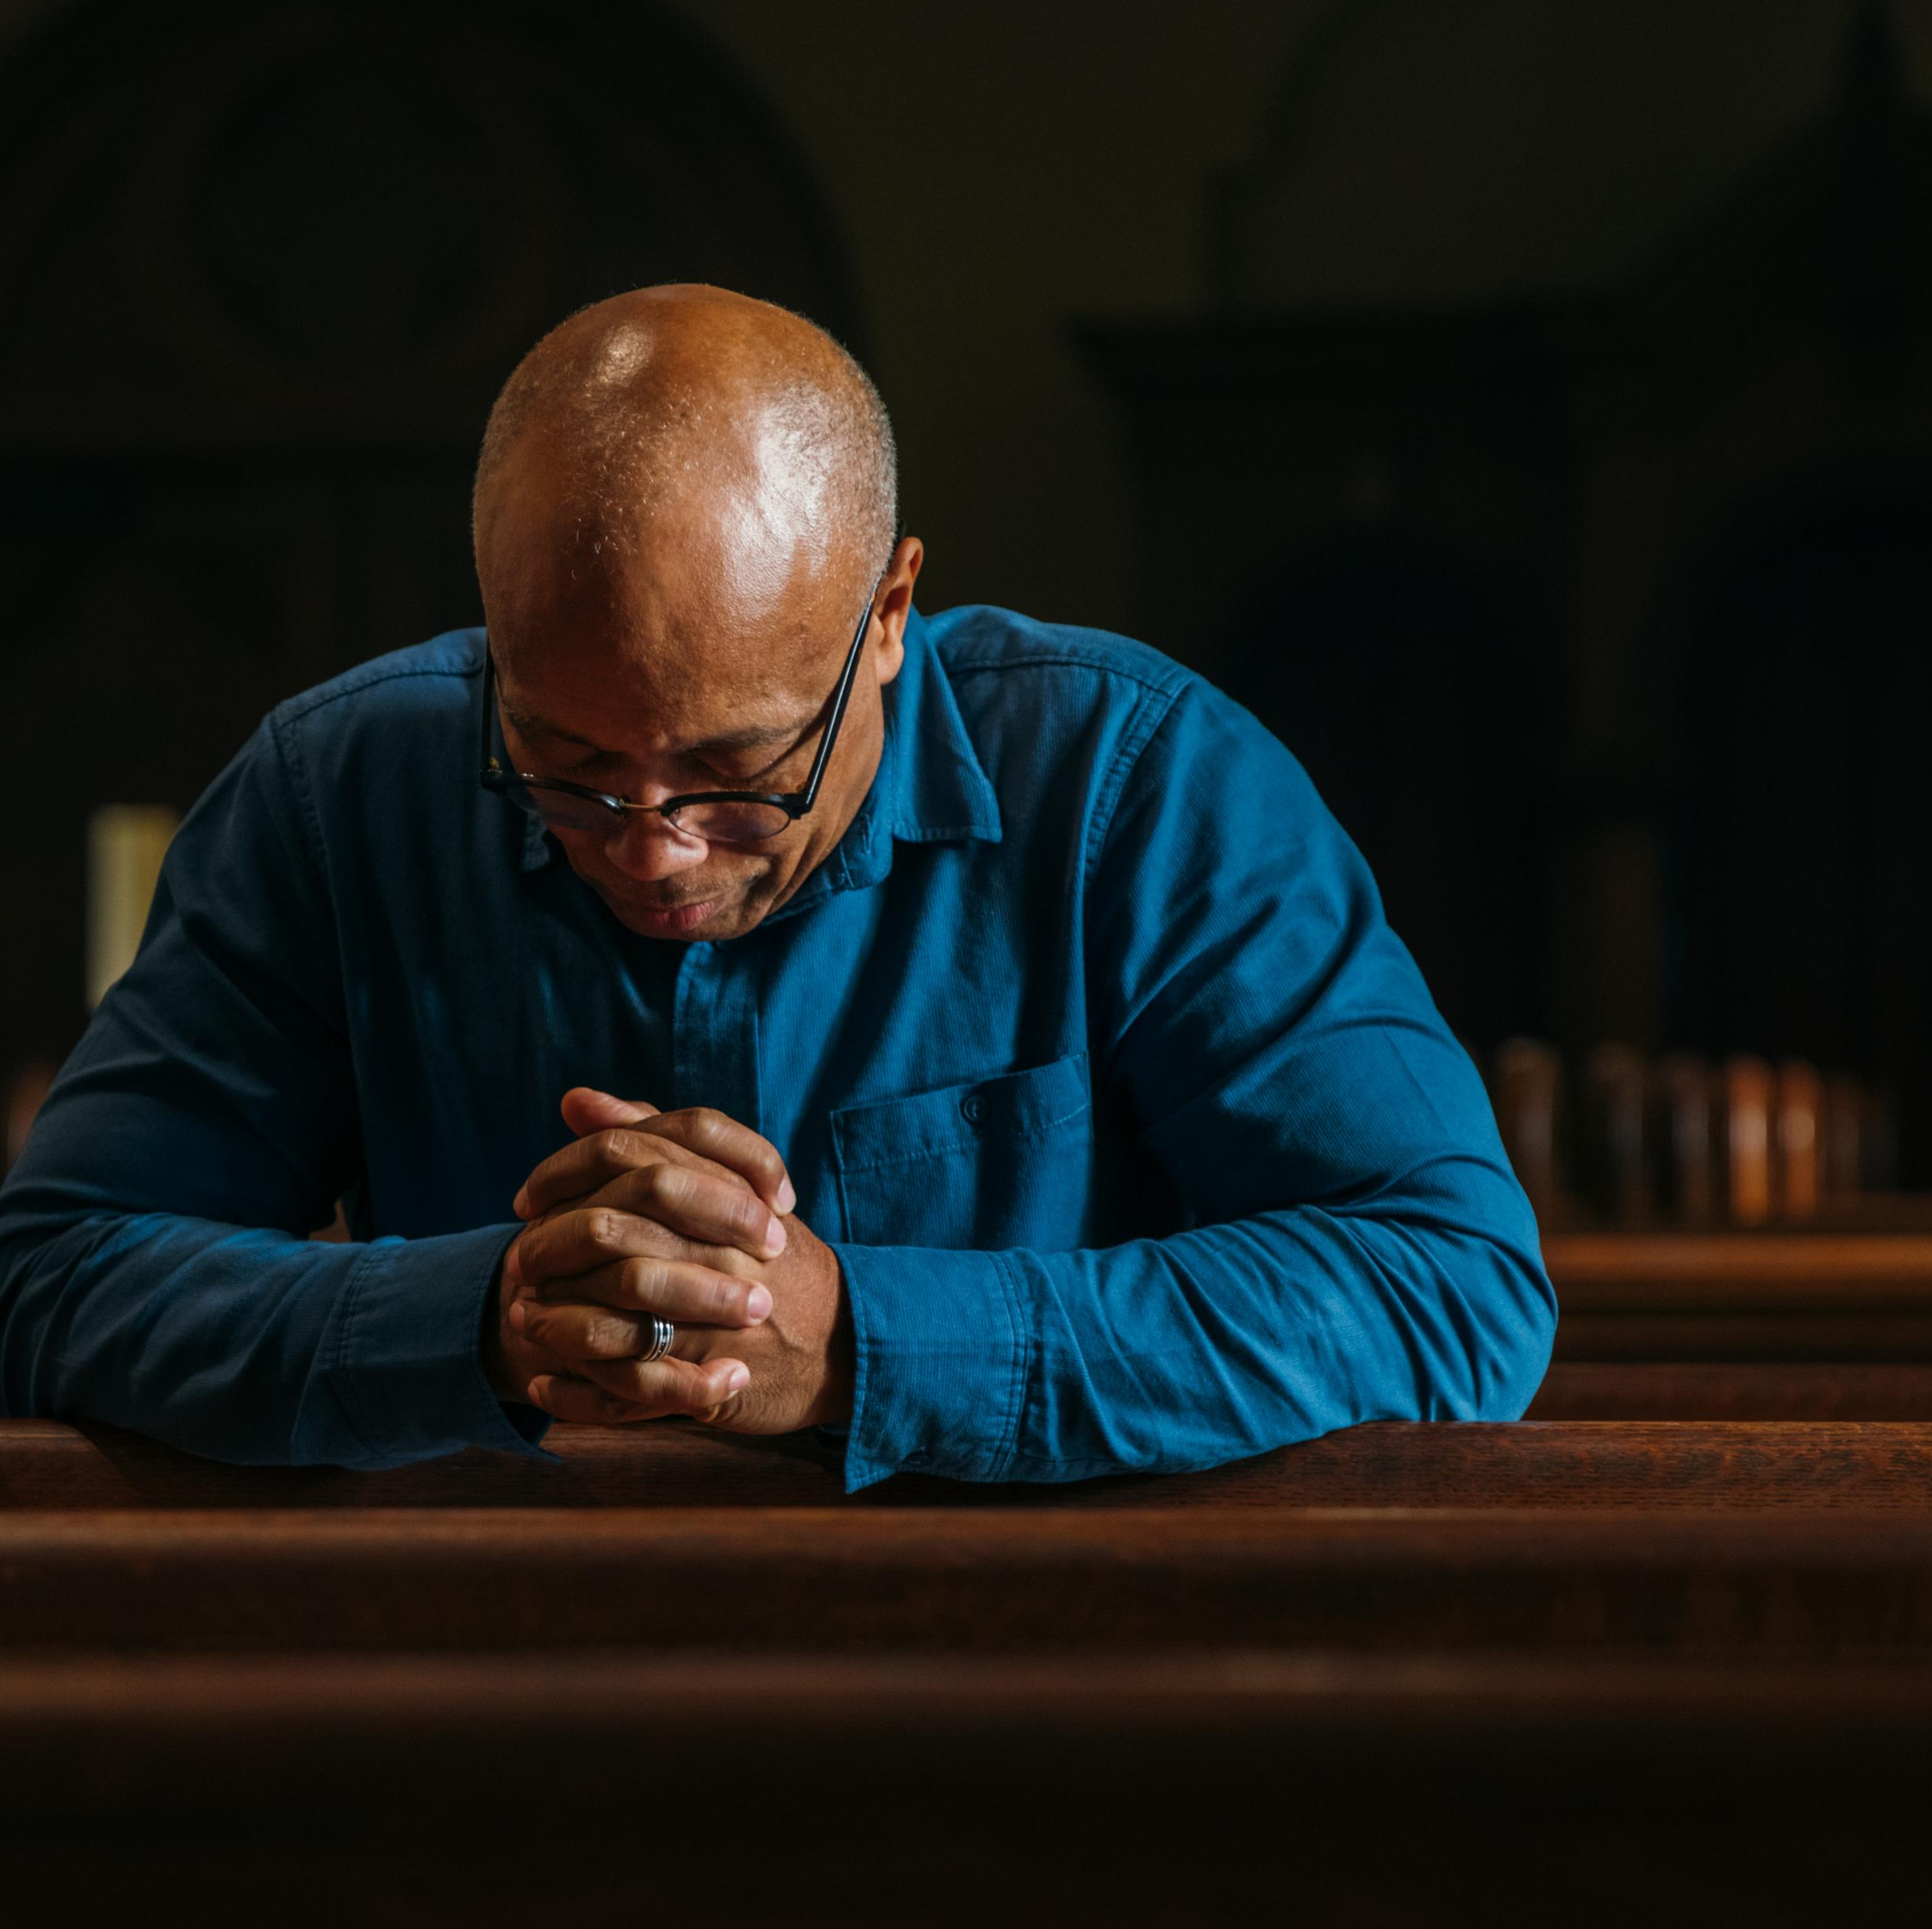

Notes:
The answer is, we begin with prayer. This is how we begin most everything when we live a Christian Stewardship way of life.
We make our decisions after prayerfully considering what we want to return to our Lord. This is true with time, talent, and treasure. For the purpose of this presentation, I want to focus on the stewardship of treasure.
I want to give you the tools that will help you to decide what you want and can give to God for all the good He has done for you.

Slide 11
A Christian Steward is:
One who receives God’s gifts gratefully
Cherishes and tends them in a responsible and accountable manner
Shares them in justice and love with others
And returns them with increase to the Lord
Stewardship: A Disciple’s Response
A Pastoral Letter on Stewardship
Notes:
Before we go any further, I want to remind you who a Christian Steward is …

Slide 12
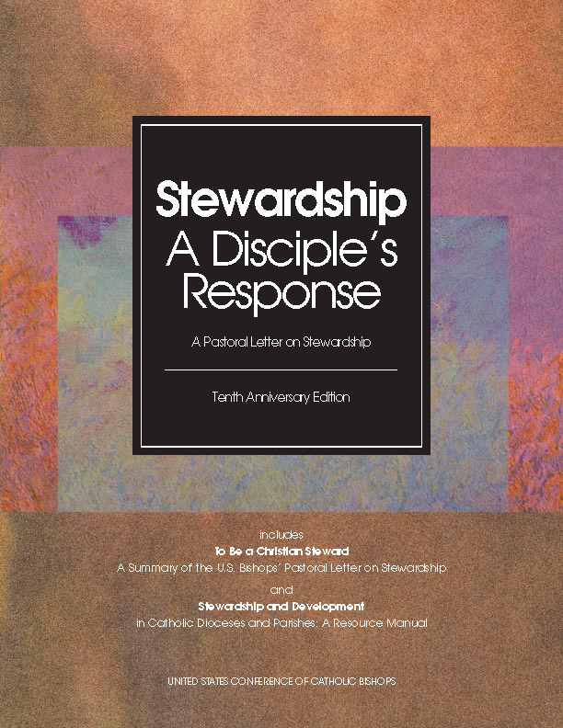
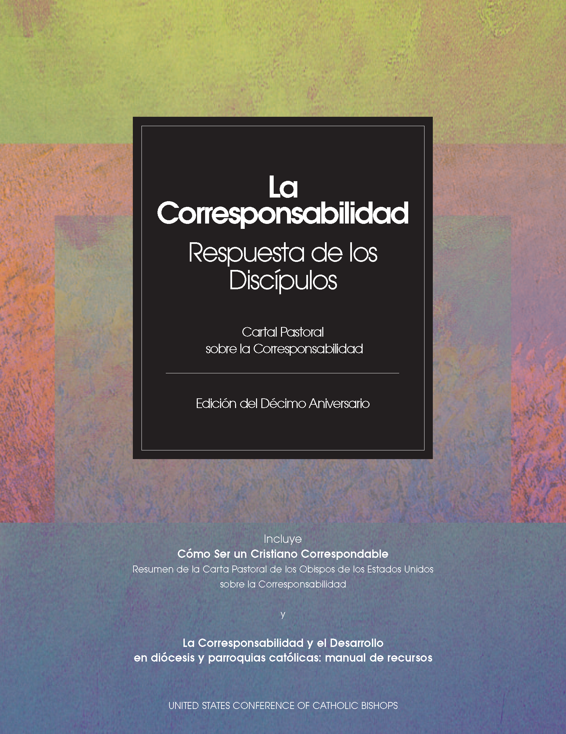
Notes:
This is from the Stewardship, A Disciple’s Response: A Pastoral Letter on Stewardship.
This document is used by pretty much every diocesan stewardship and development director throughout the United States. It was written by a committee of bishops and approved by the full USCCB. It is a great source of information for you personally and for a parish committee. It is easy to read and it’s in English and Spanish. A pdf of the Letter is on our stewardship web page, so access is easy.
To summarize who a Christian Steward is,
To live a stewardship way of life, we must understand that a total commitment to stewardship is planned, proportionate, and sacrificial. It is important to set goals for giving, whether it is time, talent, or treasure. To do this, we prayerfully consider the gifts we have received from God. And then make a decision about what we will give.

Slide 13
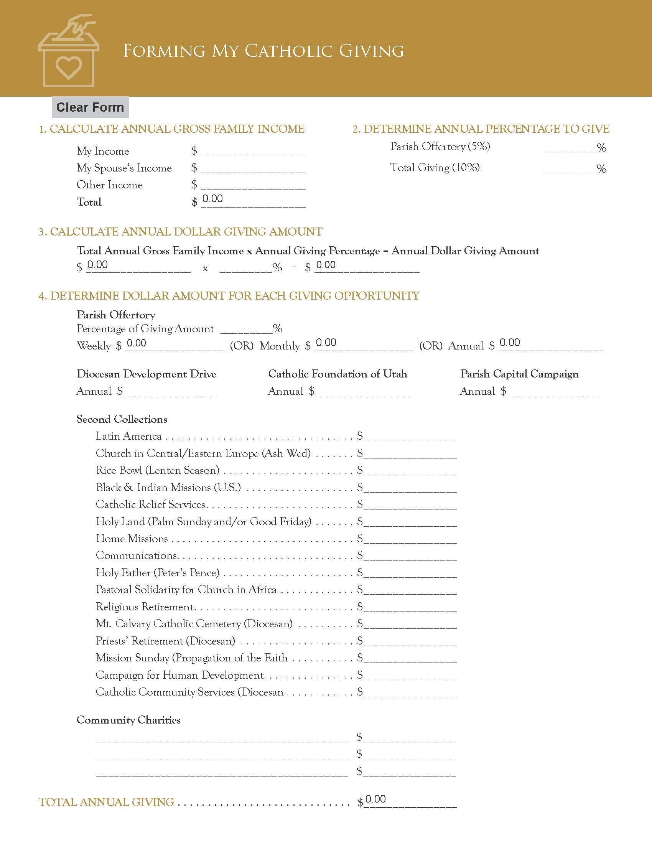
Catholic Giving Form
Notes:
I want to introduce you to a form we have created for our Diocese. It is titled, Catholic Giving Form. It is an interactive form to assist you in determining your Stewardship of Treasure for a year. It allows you to enter in your financial information and play around with what percentage of your income you would like to give. It lists many areas where the diocese and your parish or mission is asking you to give.
It is on the Diocesan website under Stewardship and Development and also under Stewardship, Our Way of Life.
You can begin using this form after you have spent time in prayer.
Let’s take a listen to a tutorial of the form.

Slide 14
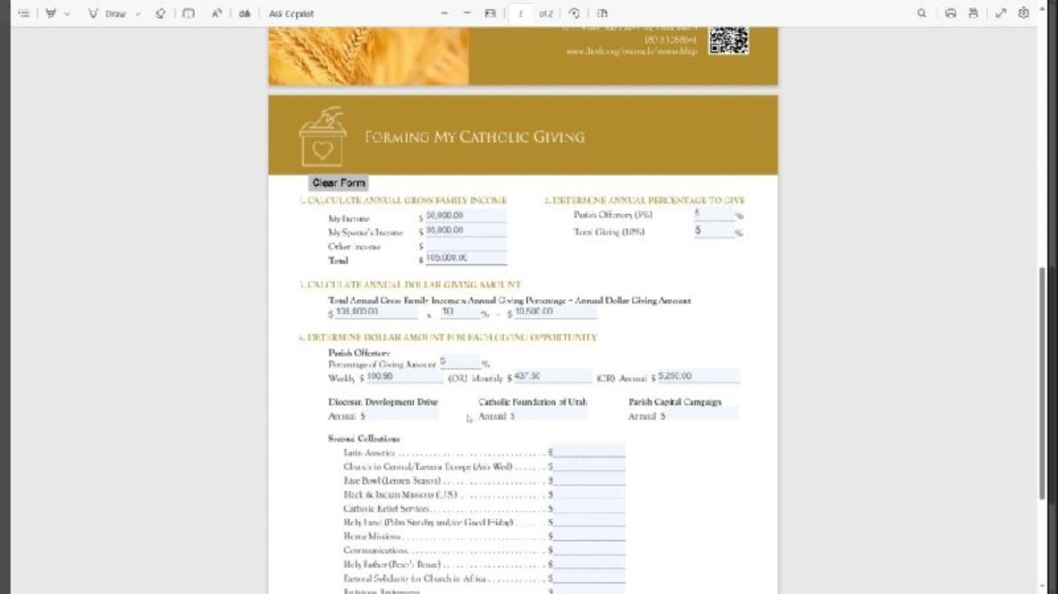

Slide 15

How to Give
Online Giving
CC, ACH
USPS
Check
Offertory Basket
Check
Cash (with envelope)
Notes:
Now that you have decided what your giving will be, what is the easiest and best way for you to give. At the Diocese, and at most parishes, we offer a few options …

Slide 16
Notes:
Let’s pause for a minute … Yes this slide is blank for a reason. If you have been here all day you must be tired. You’ve received a lot of information from the presenters – great information.
Stewardship is an important effort for our Diocese. In fact, Bishop Solis will be speaking about it at the Fall General Assembly.
So lets take a breath … breathe … And we continue.

Slide 17

How to introduce stewardship to your parish/mission
Notes:
I hope you all attended Liz Kirts two very informative presentations. If you missed them, her slides will be on our stewardship webpage on Monday, maybe Tuesday.
This wonderful day will be over soon, and we will all go back to our parishes and missions. How do we process the information we have received?
We can’t keep quiet about what we have learned today. We need to talk about how living a stewardship way of life can change your life – for the better. Who doesn’t want that?!
But how do we do that?

Slide 18
Speak to your Pastor.
Take a leadership role.
Make a stewardship plan.
Place a link on your website so your parishioners can download the Catholic Giving Form.
Print the form and insert into your parish bulletin.
https://www.dioslc.org/outreach/stewardship/
stewardship-resources
Notes:
First of all, you speak to your pastor. Let him know what you learned today. Let him know that YOU are going to take a leadership role in making your parish a stewardship parish.
Then - Make a stewardship plan. And make the form part of your plan. We have a stewardship manual listed on our Stewardship web page as a resource. Samples are in the back if you would like to see it. The Manual takes you from day one on how to become a stewardship parish and beyond.
In the meantime, you can begin using the form, offering it to your parishioners.
You can print it off from our website, or you can download, print and copy for your bulletins.

Slide 19
Notes:
Remember, the first step is prayer. It’s simple, it’s easy. You then move forward.
Thank you all for attending. I hope this was information you can use personally, and also share with your fellow parishioners.

Slide 20

Questions
Comments
Notes:
Any questions regarding the Catholic Giving Form or the Diocesan Stewardship Liaison form?

Slide 21
Shannon Lee
Director
Office of Stewardship and Development
Catholic Diocese of Salt Lake City
801-456-9328
shannon.lee@dioslc.org
www.dioslc.org/outreach/stewardship
Notes:
Call me if you need assistance or want a few ideas to inform your community and your pastor.

